Slide 1
An integrated high-level hardware/software partitioning methodology
By Cliff Kirkman
Notes:
The topic I have chose is integrated high-level hardware/software partitioning methodology, to begin with I am going to go through what it is, why you would want to use it, how it relates to embedded systems and then more importantly how it relates to parallel computing.
Say which slide you start talking about its relationship to parallel computing

Slide 2
Introduction and Motivation
What is an hardware/software partitioning methodology?
The target technology for this methodology is Field Programmable Gate Arrays (FPGAs) and other programmable hardware
Why would you want to use hardware/software partitioning?
To save time and resources when designing systems which use programmable parts e.g. FPGAs
Speed up time-to-market
Save development costs
Easy to use design tool integrated to CAD – Designed can interact with tools to effect or modify outcome
Consideration of factors which could be missed otherwise
Partitioning happens quickly within a predictable time frame
Notes:
What is an hardware/software partitioning methodology?
When developing a product you must consider what features will be implemented using hardware and what ones will be implemented using software. There is a methodology which acts a guide line to make these decisions, during this presentation I will talk about how this process has been attempted to be automated
Via CUPSHOP Cairo University Pso-based Hardware Software partitioning tool, with a strong focus on the partial swarm optimization algorithm and how that algorithm uses parallel computing to help solve the problem.
The target technology for this methodology is Field Programmable Gate Arrays (FPGAs) and other programmable hardware
Why would you want to use one?
The main reason is to save time and resources when designing systems which use programmable parts e.g. FPGAs
This can be proven by the time it takes a product to get to market, since our industry is very fast moving this can be very important to share holders.
Using this methodology and combining it with automation and parallel computing you can save money on development costs.
CAD is a widely used piece of software which many developers are already familiar with, having this tool integrated with CAD makes it easier to use.
It can be used to help calculate development costs of a both types of implementations, buy not just the currency value but costs of all areas are considered for example: area, delay, latency, and power consumption.

Slide 3
HW/SW partitioning
Features of optimized partitioning algorithms:
Application domain, taking into consideration if the algorithm is multi-domain or specific domain
Architecture type, different approaches work differently on different architectures
Communication costs, speed at which different method communicate can be important
Choosing implementation based on alternative hardware nodes
Choosing implementation based of sharing resources amongst more than one node
Using the abilities of hardware and software parallelism
Mode type, single or multi-mode system
Decisions based on parallelization factors
Notes:
Features of optimized partitioning algorithms:
Something make work better on x86 compared to amd64, algorithm considers this.
Dependent on what embedded system you are using, hardware will likely be slower to communicate than software, speed is a factor.
Depending on which type of node you have you may want to implement differently.
Implementation based on sharing resources, between nodes, means it considers how resources will be used if the system was parallelized across a multi-node network. For example should multiple nodes need to share resources then in the design it will help to decide what the optimal amount of nodes to use is, based on cost, more details on this in next slide.
Algorithm also considers how software or hardware will parallelise tasks, some tasks are better at working in parallel on one type better than the other.
If system has to switch between different modes, this may also factor in on how it decides to allocate tasks between hardware and software.
Based on these factors the partitioning tool was built to find most efficient cost.

Slide 4
How cost is considered in relation to a parallel system
When considering cost in a parallel system the main factors we look at are:
Cost of communication between nodes/threads – threads overlapping = more communication time
Nodes working in a network cluster - the delay of communicating over a network.
Should parallelisation be done on one piece of hardware with more software focus or multiple pieces of hardware to gain more power but increase costs
Using more hardware in parallel increases power consumption cost but in software this is not as important of a factor unless it’s a limited low power embedded system
Using more hardware in parallel increases area cost, meaning number of logical elements or CPU area may be a limiting factor
Notes:
Cost of communication between nodes/threads
When generating a design, the program considers how many nodes or threads to use. When using multiple nodes, if they are accessing the same parts of memory then there can be overhead which occurs when one node has to wait for another to finish its memory read/write. If a lot of overlap occurs this can increase the time and therefore the cost of operations the program has to complete.
If the optimal software design including nodes working across a cluster, then a communication cost has to be considered since you have to allow for time between these nodes, having different threads on the same CPU is faster than having different nodes operating over a network, when the task is not extensive but when you have a very extensive task you may need to consider using the power of multiple pieces of hardware.
Another factor which is considered, when adding more hardware to work in parallel is power consumption cost, there may be a limit on how much power a system can use. When considering software optimization power is not as important factor but may be considered if its limited in a low power embedded system.
Using more hardware in parallel increases area cost, meaning number of logical elements or CPU area may be limiting factor

Slide 5
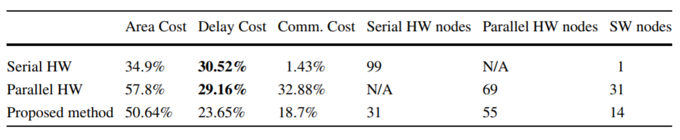
Communication cost modelling
Communication types which are used to help nodes/threads work in parallel
Point-to-point communications
Bus-based communications
Shared memory communications
Network-based communications
Example of cost modelling to determine best hardware solution according to communications:
Notes:
There are four communication types to be considered when generating a cost model.
Hardware and software communications can be separated four ways:
Point-to-point communications which means nodes connecting directly to one another
Bus-based communications which means nodes/threads communicating over system bus
Shared memory communications which is when nodes/threads use the same memory area, important to note when accessing area of memory the node must lock it off to avoid corruption.
Network-based communications, for when nodes communicate over the network.
Here is an example of some cost modelling results.
The serial line shows us the use of the least amount of area, but highest delay cost since it takes longer and a very low communication cost since there are only serial hardware nodes.
The parallel line shows the highest area cost, and lower delay meaning it completed in less clock cycles than previous. The biggest downside is the communication cost since there are a lot of nodes there has to be a lot of communication.
The proposed method shows the optimal amount of nodes to use to have the lowest delay cost. by having less nodes less communication occurred which allowed operations to compete faster.
Jigang W, Srikanthan T, Chaen G (2010) Algorithmic aspects of hardware/software partitioning: 1D
search algorithms. IEEE Trans Comput 59(4):532–544

Slide 6
Introduction to Re-excited Particle Swarm Optimization(PSO) algorithm
Using PSO to solve partitioning of hardware and software design in programmable devices
Solutions are found at random to begin with, then based on solution results over each iteration by following current best solution the most optimal one can be found
Specifically for hardware and software partitioning methodology:
Generate set of solutions with random amount of serial nodes, parallel nodes and power implementation
After each round based best performances, generate new set with similar amounts
Keep repeating until optimal solution is found or set number of rounds is met
Notes:
Using a PSO to solve partitioning of hardware and software design in programmable devices
Very brief overview of PSO.
PSO is an algorithm inspired by animal social behaviour like bird flocks, potential solutions move around following the path of the current best solutions.
To solve the problem of hardware and software partitioning, solutions are randomly populated, then based on generated solution data which is exchanged the best solution can be narrowed down by following the currently looked at best solution.
First line of advantages of this methodology? – TODO CHECK
When deciding how part of a product should work, this methodology helps you consider the advantages and disadvantages of both. For example choosing a software module are easier and faster to develop and change. Which means it costs less time and money to develop that module but hardware provides better performance.

Slide 7
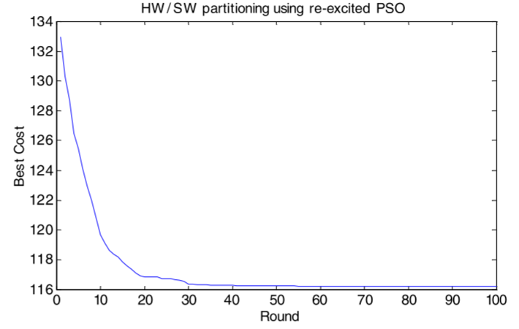
Example results of HW/SW partitioning using re-excited PSO
Notes:
Example of improvements over PSO runs, shows after first 10 there is a dramatic increase in optimal cost, the improvements after this are minimal. It shows what an effective solution this is.

Slide 8
Experiments/Case study
Notes:
What experiment
How experiment created optimal parallel solution
10/32 3.4 case study
Explain JPEG coder case study
What it did, what the results were
How parallel computation effected/benefited results
Do this over two slides, figure out how it would take to present, add summary type slide if you need to extend time. Add UWE Harvard reference for pdf

Slide 10
Questions

